Slide 1


Harvesting Insights: A Drought-Focused Agriculture Data Study
By: Jonathan Busch, Josh Corry, Emily Spector, James Parker

Slide 2
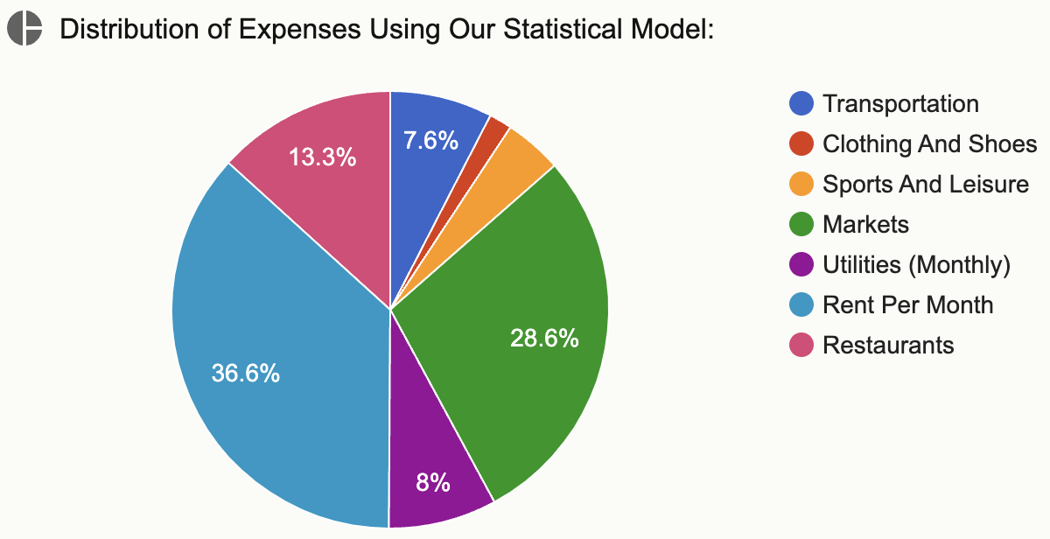
Interest in Dataset
Millions Employed Within Agricultural Industry
According to Numbeo’s cost of living calculator, the cost of food accounts for approximately 41.9% of the standard cost of living (Restaurants and Markets).
Understand Relationships of Agricultural Employment, Producer Price Index of Food and Droughts
Notes:
Josh

Slide 3

Dataset Source
Econometric Variables Sourced from the St. Louis FED captured either monthly or yearly
Area Drought and Population Drought Data Sourced from the University of Nebraska Drought Monitor captured weekly
Datasets combined using merge functions in python
Notes:
Josh

Slide 4
Data Description
Abbreviation | Variable Name | Description
PAD1 | Percent Area Drought | % of United States area considered to be in a drought
FCET | Farm Cattle Employment in Thousands | The employment in thousands in farm or ranching related industries
AGSBillions | Agricultural Subsidies in Billions | Government spending on the agricultural sector of the economy in Billions
YIR | Yearly Inflation Rate | Change in value of money as a percent of the delta of the producer price index of all goods versus a base year
PPIF | Producer Price Index of Food | What percentage of the land is affected by drought at the given time (US)
PPD1 | Percent Population Drought | What percentage of the population is affected by drought at the given time (US)
Notes:
Josh

Slide 5
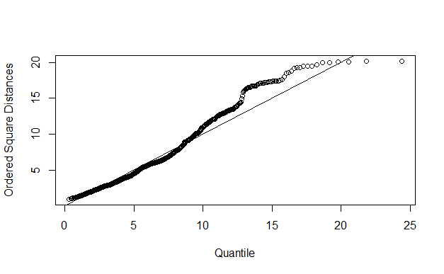
Data Cleaning and Visualizations
Originally time series data.
Converted time to row names
"1-Jan-00" "2-Jan-00" "3-Jan-00" "4-Jan-00"
We were originally going to have more variable describing different drought levels
"PADNoDrought”, "PAD1”, "PAD2" etc.
We decided to just include level 1 drought
Outliers
Every week from 2020 was an outlier
Notes:
Josh

Slide 6
Dimension Reduction
To find variables that are related in expected ways we choose to use PCA as a form of dimension reduction to find these hidden relationships
This will also allow us to create names for each of the reduced dimension that tell a concise story for each of these hidden relationships
Further analysis could then be done to understand why these relationships are occurring
Notes:
emily

Slide 7
Dimension Reduction Analysis
For our dataset we chose to do PCA for dimension reduction
The first 3 PCs represented 76.9% of variance
Loadings | Comp.1 | Comp.2 | Comp.3
PAD1 |  | 0.559
FCET |  |  | 0.787
AGSBIllions | -0.501
YIR |  | 0.549
PPIF |  |  | -0.540
PPD1 | 0.610
Notes:
emily

Slide 8
Components
Component 1: High Drought and Low Subsidies
Component 2: Drought and Inflation
Component 3: High Farm Cattle Employment and Low Price of Food
Notes:
emily

Slide 9
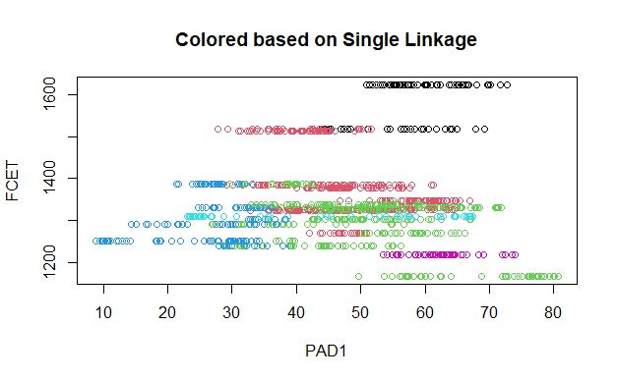
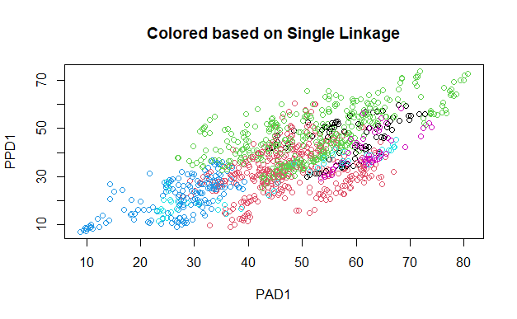
Cluster Analysis-Single Linkage
Notes:
James

Slide 10
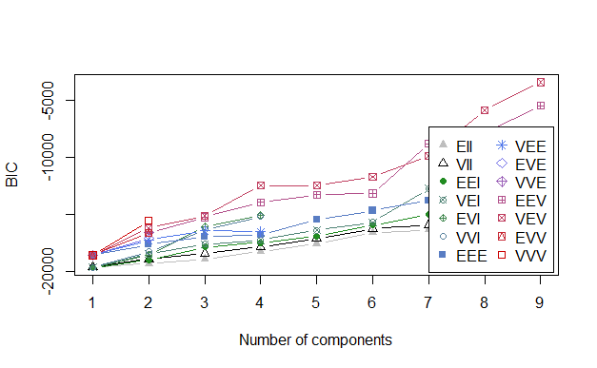
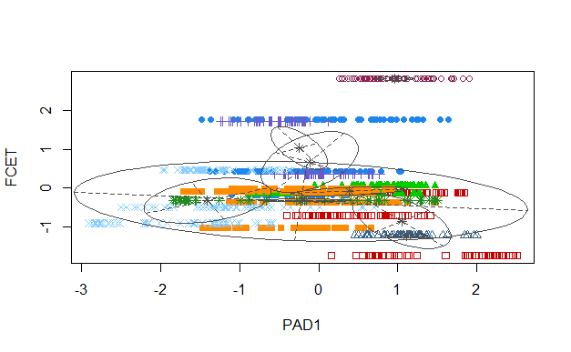
Cluster Analysis-Model Based
Notes:
James

Slide 11
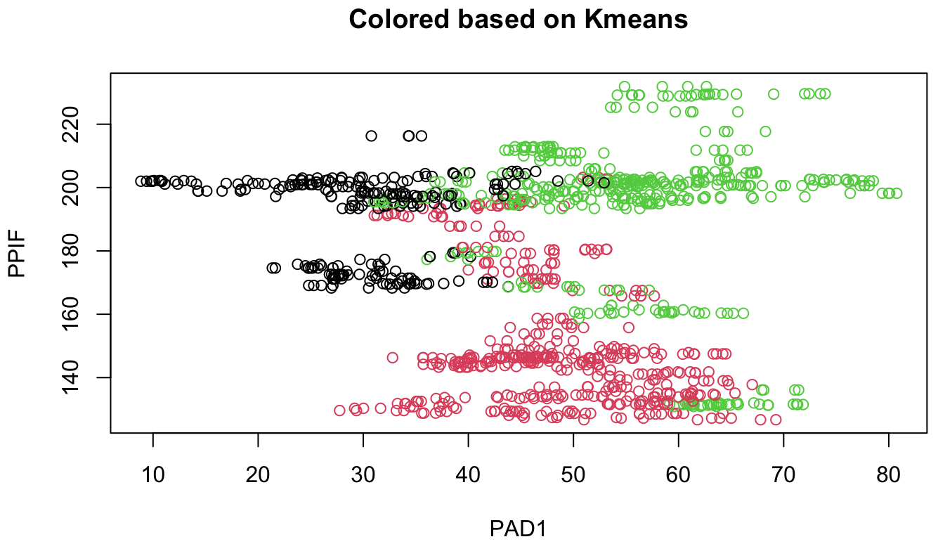
Cluster Analysis K-Means
We performed cluster analysis of our data using a few different methods: Hierarchical clustering using complete, single, and average linkage methods, K-means clustering, and model-based clustering
We decided that K means clustering produced the most interpretable clusters
Notes:
James

Slide 12
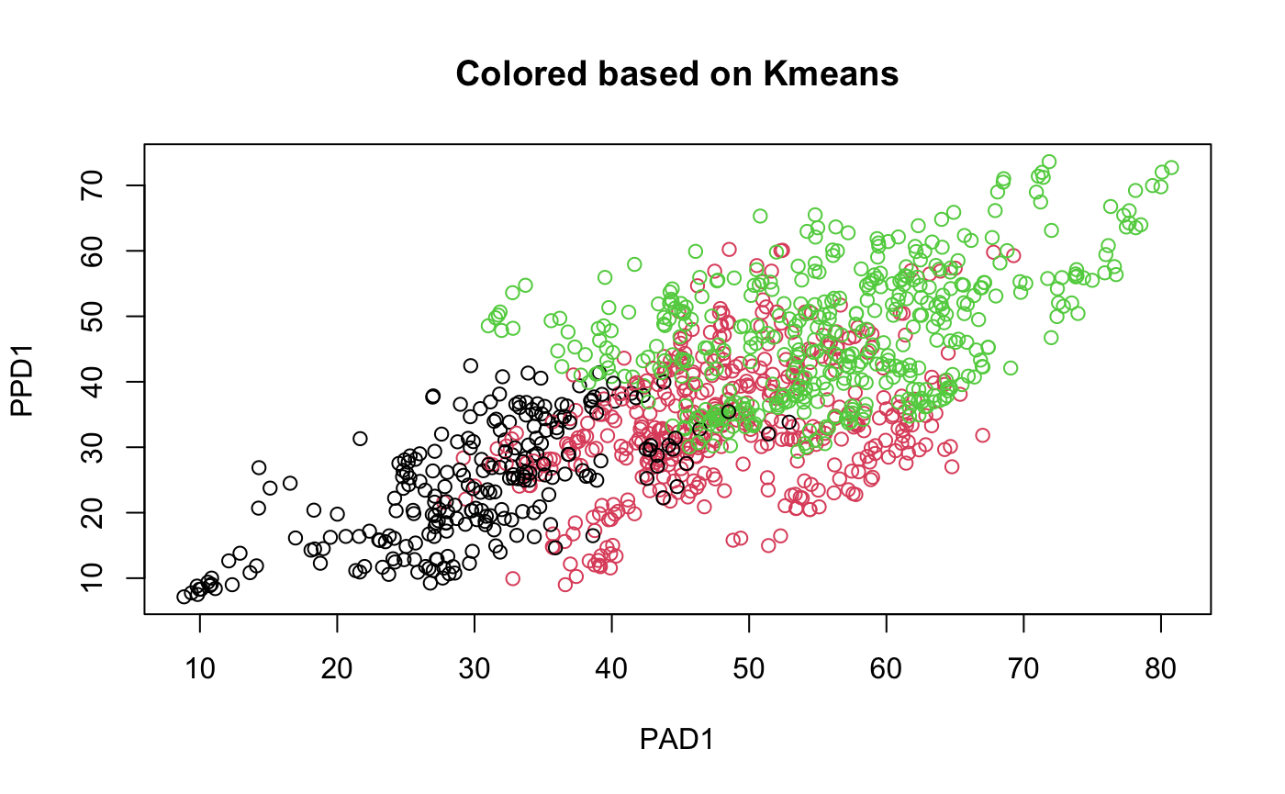
Interesting Note
An interesting note looking at the results of our clustering is that the population drought (PPD1) and the area drought (PAD1) have a roughly linear scatterplot, which makes logical sense, as the two should be related. As greater area of land is under drought, a larger proportion of the population will also be in drought conditions.
Notes:
James

Slide 13
Exploratory Factor Analysis
Factor 1: Drought
Factor 2: Inflation
Factor 3: Food Supply
46% of Variance Explained with 3 Factors
Could Not Increase # of Factors
Loadings | Factor1 | Factor2 | Factor3
PAD1 | 0.776
FCET |  |  | -0.455
AGSBillions |  | 0.451
YIR |  | 0.542
PPIF |  |  | 0.537
PPD1 | 0.959
Notes:
Jonathan

Slide 14
Exploratory Factor Analysis
46% of Variance Explained with 3 Factors
Could Not Increase # of Factors
We performed EFA based on 3 factors
Fewer factors than 3 gave an extremely small p-value
In our 3 factor analysis, the p-value was essentially zero
Factanal() function would not allow us to use greater than 3 factors for 6 variables
Loading values were very similar to those in PCA analysis
RMSE for this exploratory model was acceptable (0.096)
Notes:
Jonathan

Slide 15
Confirmatory Factor Analysis
CFA would not run as the Optimization did not converge within the allotted iterations to try and create a model
”…it should be remembered that both principal components analysis and factor analysis are similar in one important respect–they are both pointless if the observed variables are almost uncorrelated In this case, factor analysis has nothing to explain and principal components analysis will simply lead to components that are similar to the original variables." – An Introduction to Applied Multivariate Analysis with R
Possibly due to not enough variables without high enough correlations between them
Notes:
Jonathan

Slide 16
Conclusion-Further Analysis
CFA
Possibly adding additional variables or changing the model may allow us to fix the CFA issues
Explore first PCA
Why do subsidies increase while droughts are rare
What is causing the clustering for our K-means clustering
Could it be seasonality?
Certain Years/Events? i.e., COVID
Notes:
Jonathan

Slide 17
Citations
Belvidere & Boone County, IL. Importance of Agribusiness in Supporting Economic Development. 25 July 2023, https://www.growthdimensions.org/news-and-events/p/item/51747/importance-of-agribusiness-in-supporting-economic-development#:~:text=It%20generates%20billions%20of%20dollars,processing%2C%20transportation%2C%20and%20retail.
Brian, Everitt, and Torsten Hothorn. An Introduction to Applied Multivariate Analysis with R. 1st ed., 2011.
“Cost of Living in United States.” Numbeo, 2023, https://www.numbeo.com/cost-of-living/country_result.jsp?country=United+States.
St. Louis FED. “Employment for Agriculture, Forestry, Fishing and Hunting: Cattle Ranching and Farming (NAICS 1121) in the United States.” Federal Reserve Economic Data, 1 Jan. 2022, https://fred.stlouisfed.org/series/IPUAN1121W200000000.
St. Louis FED. “Government Subsidies: Federal: Agricultural.” Federal Reserve Economic Data, 1 Jan. 2022, https://fred.stlouisfed.org/series/L312041A027NBEA.
St. Louis FED. “Inflation, Consumer Prices for the United States.” Federal Reserve Economic Data, 1 Jan. 2022, https://fred.stlouisfed.org/series/FPCPITOTLZGUSA.
St. Louis FED. “Producer Price Index by Industry: Food Manufacturing.” Federal Reserve Economic Data, 1 Jan. 2022, https://fred.stlouisfed.org/series/PCU311311.
University of Nebraska. U.S. Drought Monitor. 3 Oct. 2023, https://droughtmonitor.unl.edu/DmData/DataDownload/ComprehensiveStatistics.aspx.
Notes:
Jonathan

